Slide 1
Mapping Possible Meeting-Length
for Two Trajectory-Gaps
Michael Ung and Ruolei Zeng
CSCI 8715: Spatial Data Science Research - Spring 2022

Slide 2
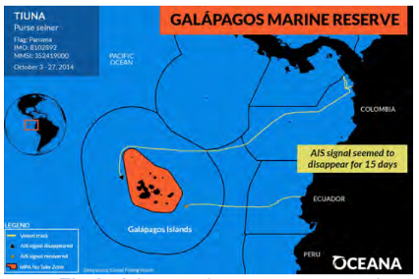
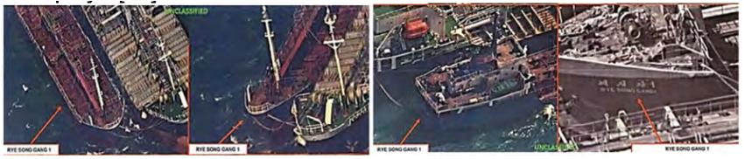
Motivation and Applications
Motivation:
Global Security: Marine Safety and Regulation Enforcement
Offenders tend to switch off GPS transponders to hide movements
E.g., Fishing vessels switched off AIS (Automatic Identification System) for 15 days.
The location prediction with one trajectory-gap developed the motivation our work based on.
Transshipment: Shipping goods between international subsidiaries illegally.
Application:
Potentially find people/criminals
Epidemiology
Astrophysics
How Illegal Fishing Is Being Tracked From Space, Natl. Geographic, 3/12/2018
Ships in an allegedly illegal oil transfer in international waters [Source 1: Oil Backed Up, Iranians Put It on Idled Ships, New York Times, 7/4/2012.]
Notes:
Global Security: Marine Safety and Regulation Enforcement
Offenders tend to switch off GPS transponders to hide movements
Transshipment: Avoiding higher tariffs while shipping goods between international subsidiaries.
Beyond Global Security: Illegal Fishing
Fishing vessels switched off AIS (Automatic Identification System) for 15 days.
near the Galapagos Marine Reserve [Sources 2, 3], and Oman [Source 3]

Slide 3
Challenges
It is hard to define trajectory data gaps based on behavioral patterns [3] (e.g., meetup)
Current trajectory mining do not consider trajectory gaps.
To capture behavioral patterns (e.g, meetup, evasive), motion-based parameters (e.g., Speed) are not consider in current literature.
Lack interpretation of trajectory gaps.
Linear Interpolation may not be able to capture meetings of two or more trajectory gaps
It need help from domain expert to interpret trajectory gaps.
Notes:
Traditional trajectory mining approaches to underperform or fail as they assume the availability and preciseness of trajectory.

Slide 4
Related Works
Miller [1] explained the methods, history, applications in space-time prism, he also explained connection among space-time prism and other academic fields.
The classical space-time prism introduced by Hagerstrand assumes a uniform but local velocity of motion in an anisotropic space such as a two-dimensional plane [1].
Notes:
These applications include dispatch planning, social research and crime analysis, epidemiology, and environmental risk assessment.

Slide 5
Limitation of Related Work
Traditional literature do not consider Trajectory Gaps [4]
Harder to trained models due to lack of trajectory data within gaps
Requires lots of data in order to get an accurate prediction.
Current Trajectory Mining methods assumes Linear Interpolation Methods[3,4]
Such methods does not captures overall object moving capabilities.
For instance, linear interpolation may miss meetup patterns between two objects.
Uniform Behavior within Trajectory Gap
Space-Time Prism [1] assumes a uniform behavior within trajectory gap

Slide 6
Limitations of Related Work
The current work is mainly based on one object movements, not the meeting of two objects.
Without the two objects planing, the application fields are limited.
Without two objects planing, it is hard to develop multiple objects
prediction.

Slide 7
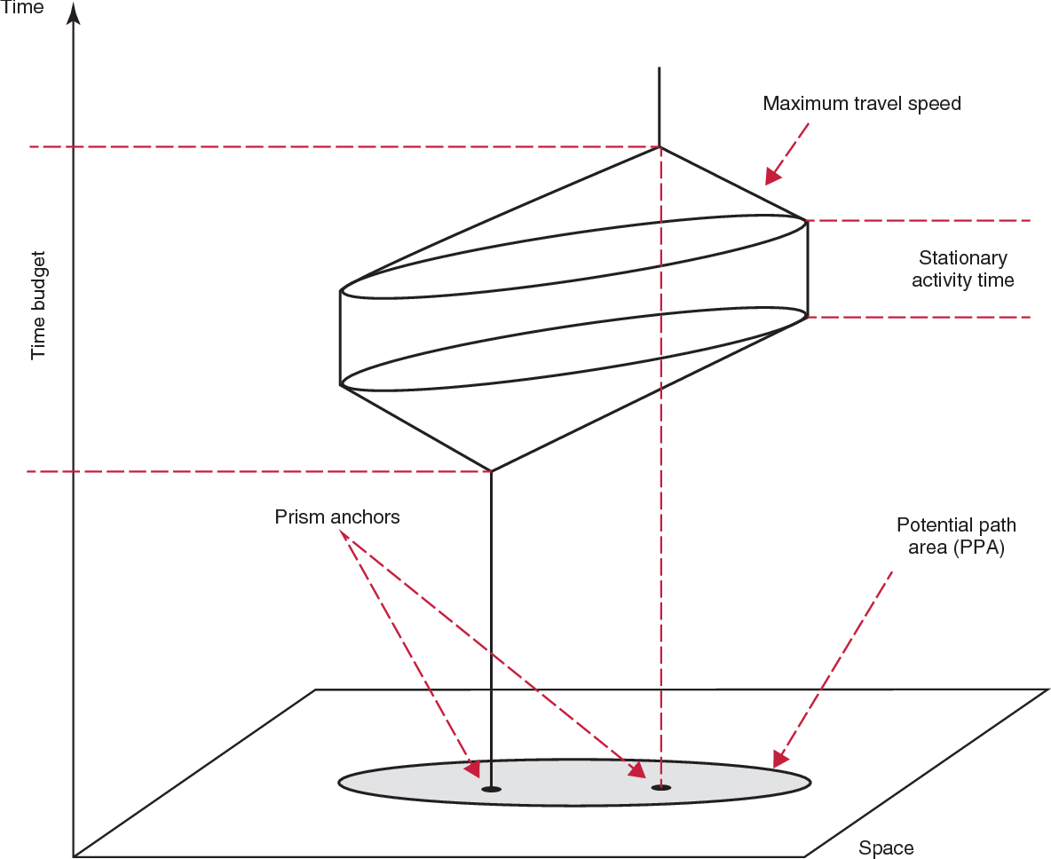
Basic Concepts
Space-Time Prism [1]: Time Geography model use to capture object's movement capability using additional information (e.g., speed and time) within a trajectory gap.
Given anchor points, the projection of the space-time prism onto the (x, y)-plane is the area bordered by the ellipse with foci with start point and end points along with long axis.
Ellipse spatially delimits the places which the moving object can have visited when traveling between anchor points via maximum speed.
Figure: 3D Representation of Space-Time Prism
Notes:
picture source: https://www.semanticscholar.org/paper/Time-Geography-and-Space%E2%80%93Time-Prism-Miller/e3add3ca59f521d50fee2a7fc9504bbaeb06359a
•Originates from the area of time geography and became popular in the area of GIS.
•
Use to model object's movement capability using additional information (e.g., speed and time) within a missing location in both unconstraint and constraint space.
Chain of space-time prisms:
The collection of space-time prisms between a sequence of anchor points is referred to as a chain of space-time prisms.
Space-Time Prism: A space-time prism between two anchor points is a geometric object in space-time prism that enclosed all locations where the moving object can possibly have been.
Constraints are the measured locations, the time interval between them and the object's speed bound.

Slide 8
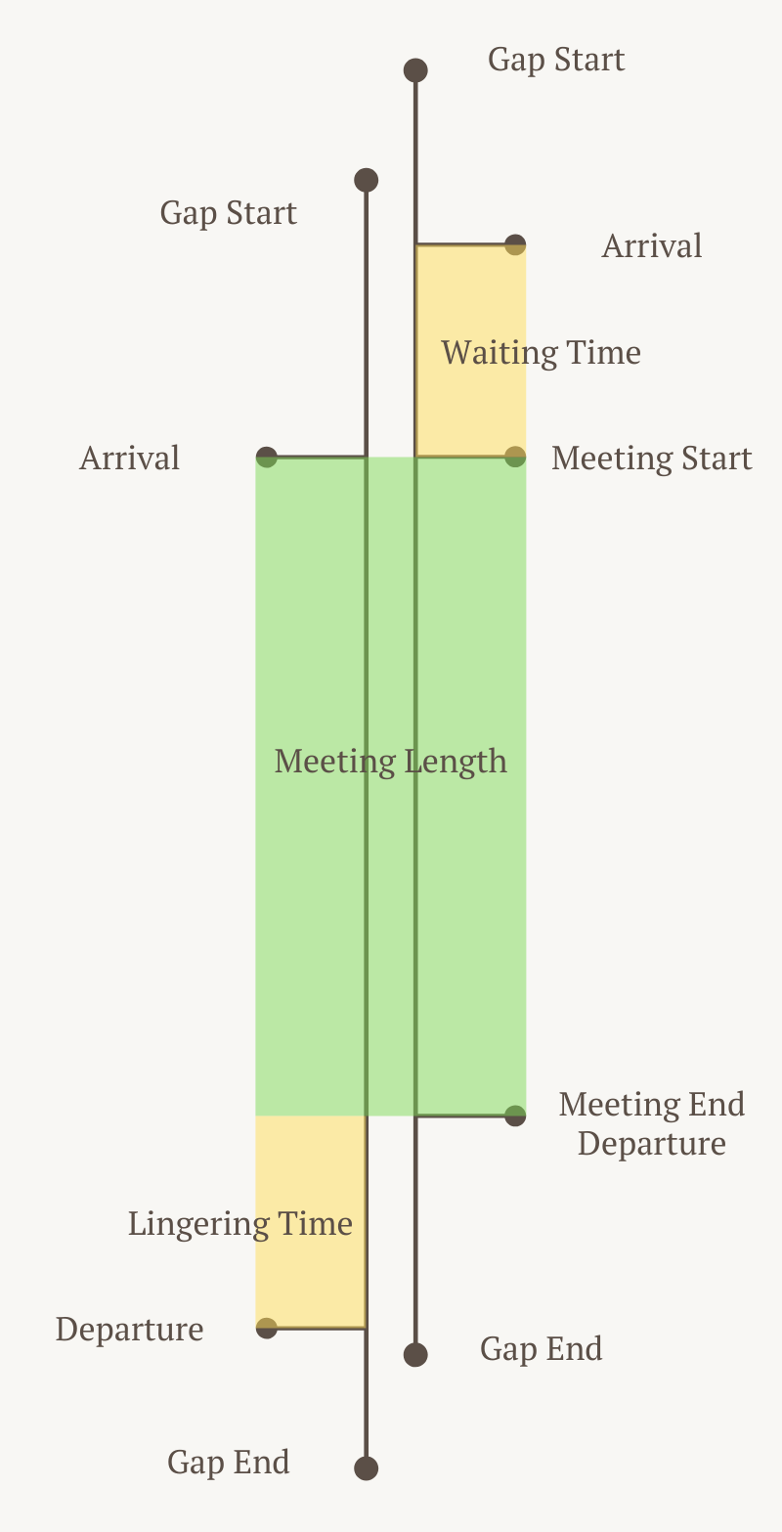
Basic Concepts
Time to Site - Length of time taken for an entity to go from start anchor to meeting location
Time from Site - Length of time taken for an entity to go from meeting location to end anchor
Dwelling Time - Time during the gap that does not consist of the Time to Site and the Time from Site
Waiting Time - Time the first object spends waiting for the second object
Meeting Time - Length of time two entities are able to meet
Fig: An Illustrative Example of Basic Concepts
Notes:
make more mathematical

Slide 9
Basic Concepts
Two trajectories with two different, but overlapping time gaps
One entity waits for the other entity to show up (waiting time)
Meet for a period of time (meeting length)
One entity leaves and proceeds to end anchor (departure)
An entity’s actions are unknown until they leave (from meeting end to departure)
Fig: An Illustrative Example of Basic Concepts
Notes:
Add Legend
Consistent Coloring throughout the slides (Red Blue and Purple/Green)

Slide 10
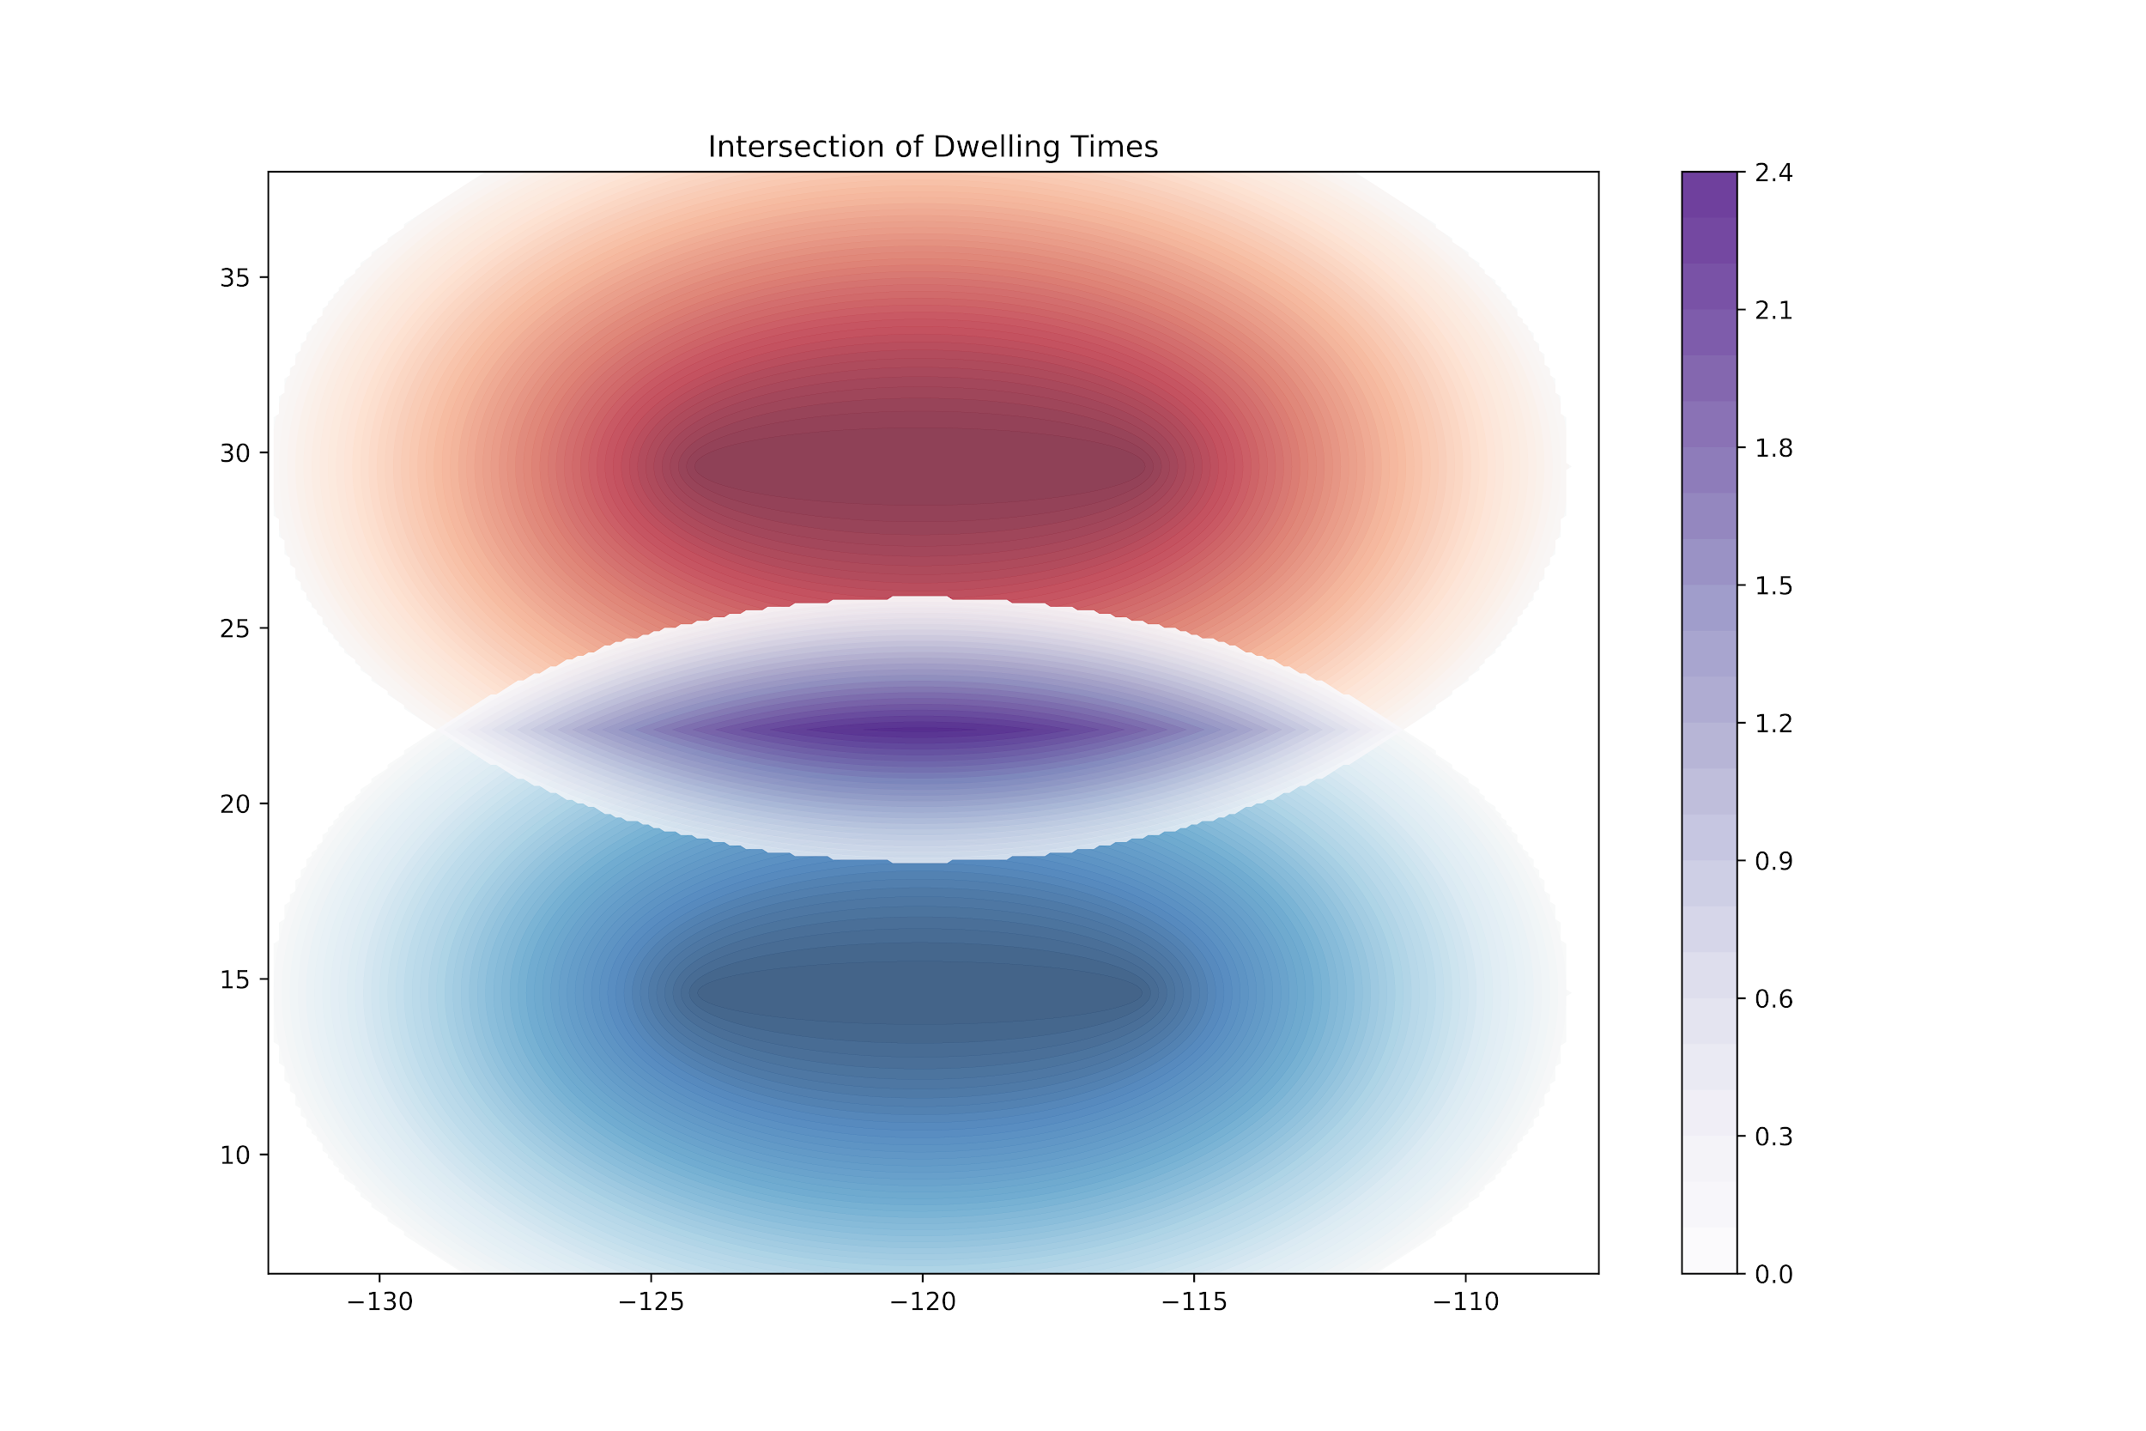
Problem Statement
Legend
y
Trajectory 1
Trajectory 2
Input:
A study area
A pair of trajectories gaps.
Multi-attributes (e.g., Speed)
Output:
Intersection of geo-ellipses with length of meeting information.
Objective:
Find possible meeting locations and lengths of two objects.
Constraints:
Acceleration is not available.
Behavior within trajectories: Object goes straight to the meeting site.
x
Input: A pair of trajectories gaps
Output: Intersection of dwelling times
Notes:
explain figures in captions, focus on intersection, anticipated behavior

Slide 11
Contribution
We defined trajectory gap behavior based on meeting time.
We calculated the potential meeting times and locations for a pair of trajectories.
We provided visualizations experimental results based on synthetic dataset.
Notes:
We defined the meeting time based on behavior in a trajectory gap.
Additionally, we also calculated locations and meeting times for a pair of trajectories.
Lastly, we visualized the meeting time and the dwelling time by experimenting on a synthetic dataset.

Slide 12
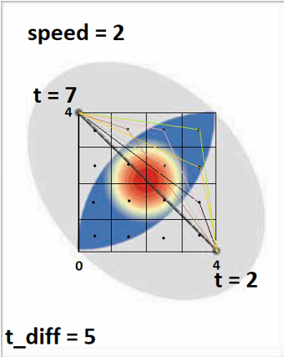
Proposed Method
Illustration of grid selection.
Choose the center of a grid to be a potential meeting location.
Calculate times to and from site using distance and speed.
tt_site = hypot(length₁, length₂) / speed
tf_site = hypot(length₃, length₄) / speed
Calculate the dwelling time
DT = gap_length - tt_site - tf_site
Calculate the dwell-time interval
DS = start + tt_site, DE = DS + DT
Calculate the meeting time
MT = INTERSECT( interval( DS₁, DE₁), interval (DS₂, DE₂) )
Notes:
WT = | (start₁ + tt_site₁) - (start₂ + tt_site₂) |

Slide 13
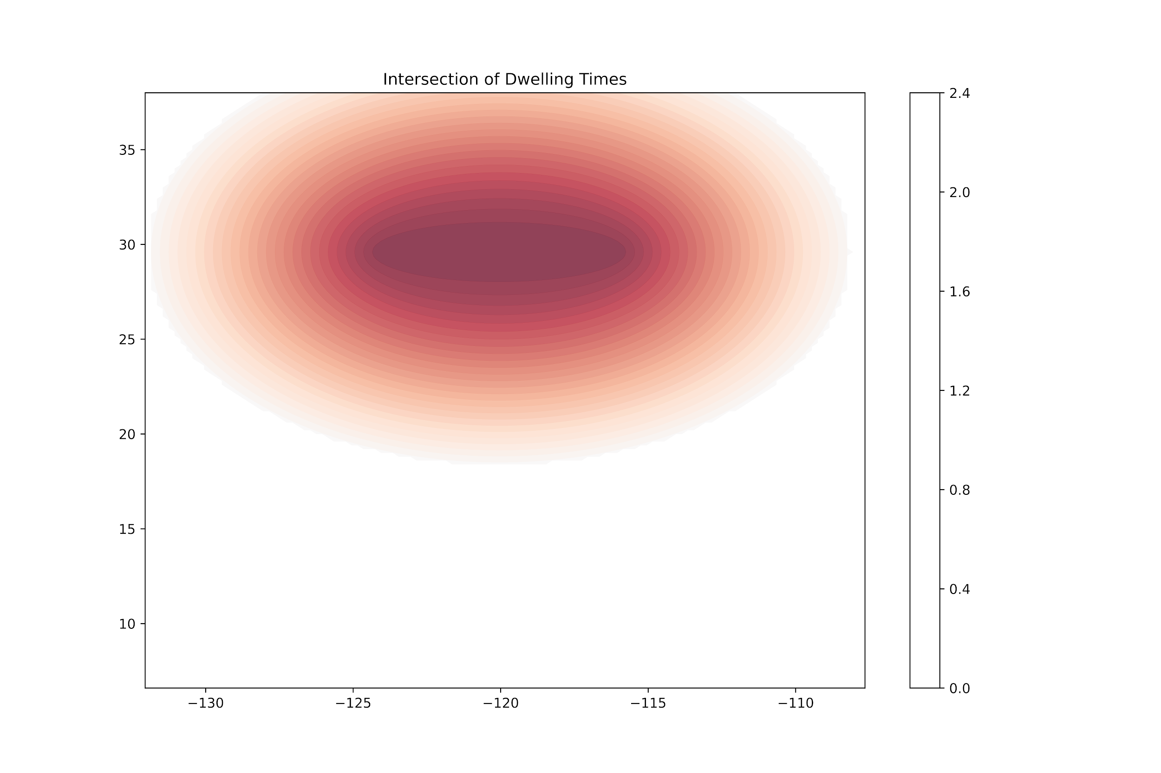
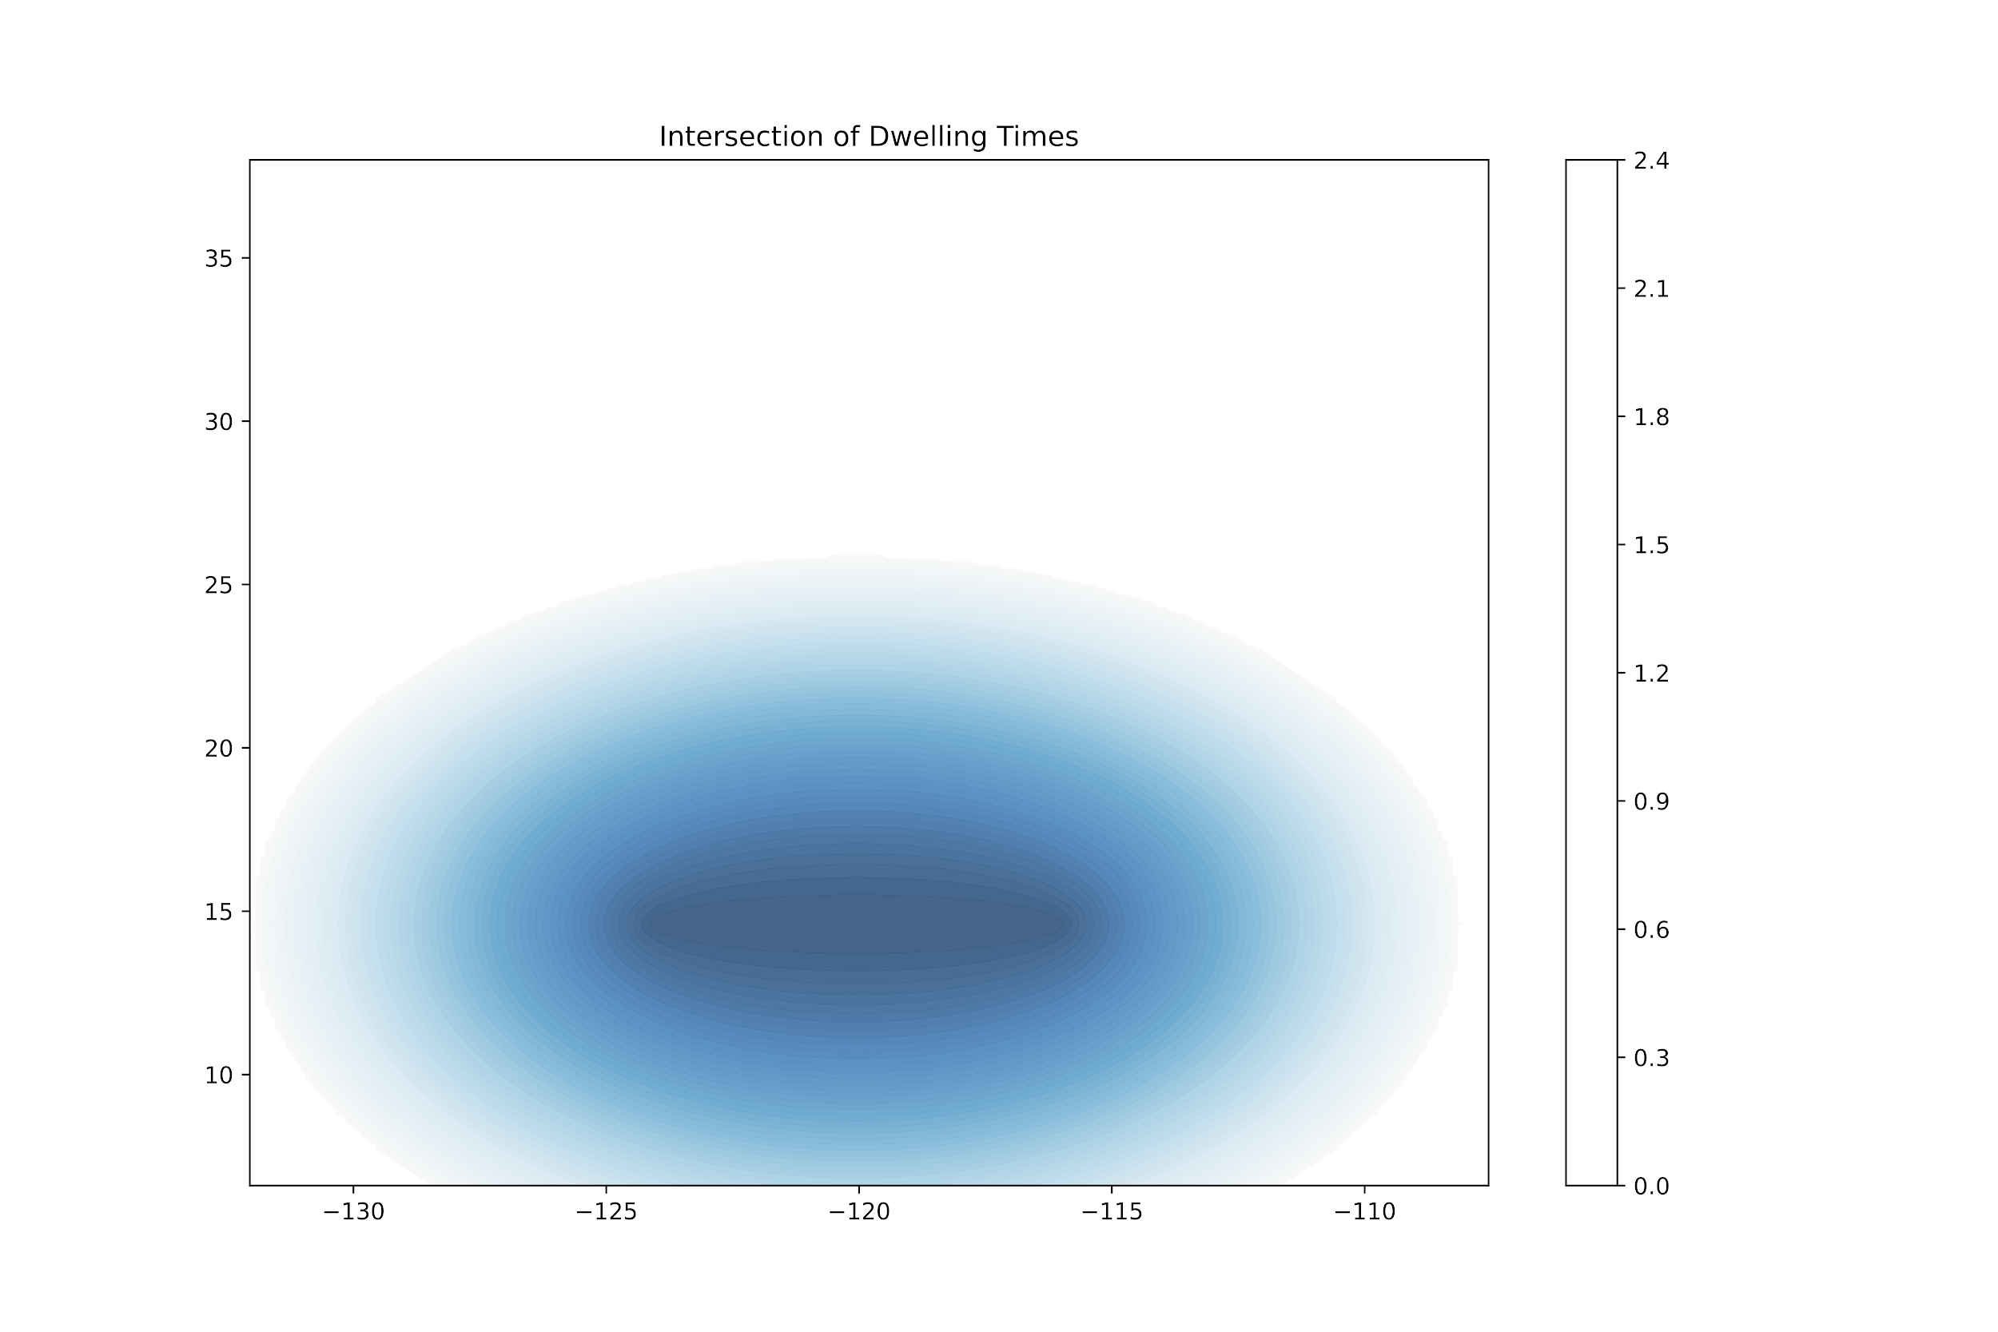
Mapping Dwell-Time Length
Calculation is done for two trajectories and plotted.
Darker color regions indicate higher dwelling times,
Extra time is present during the commute between the two anchor points
Light color regions indicate lower dwelling times:
Less time is spent during the commute between the two anchor points
Edge of the geo-ellipse indicates the entity must go there and immediately head to the end anchor.
Fig: Dwell-times for individual trajectory gaps

Slide 14
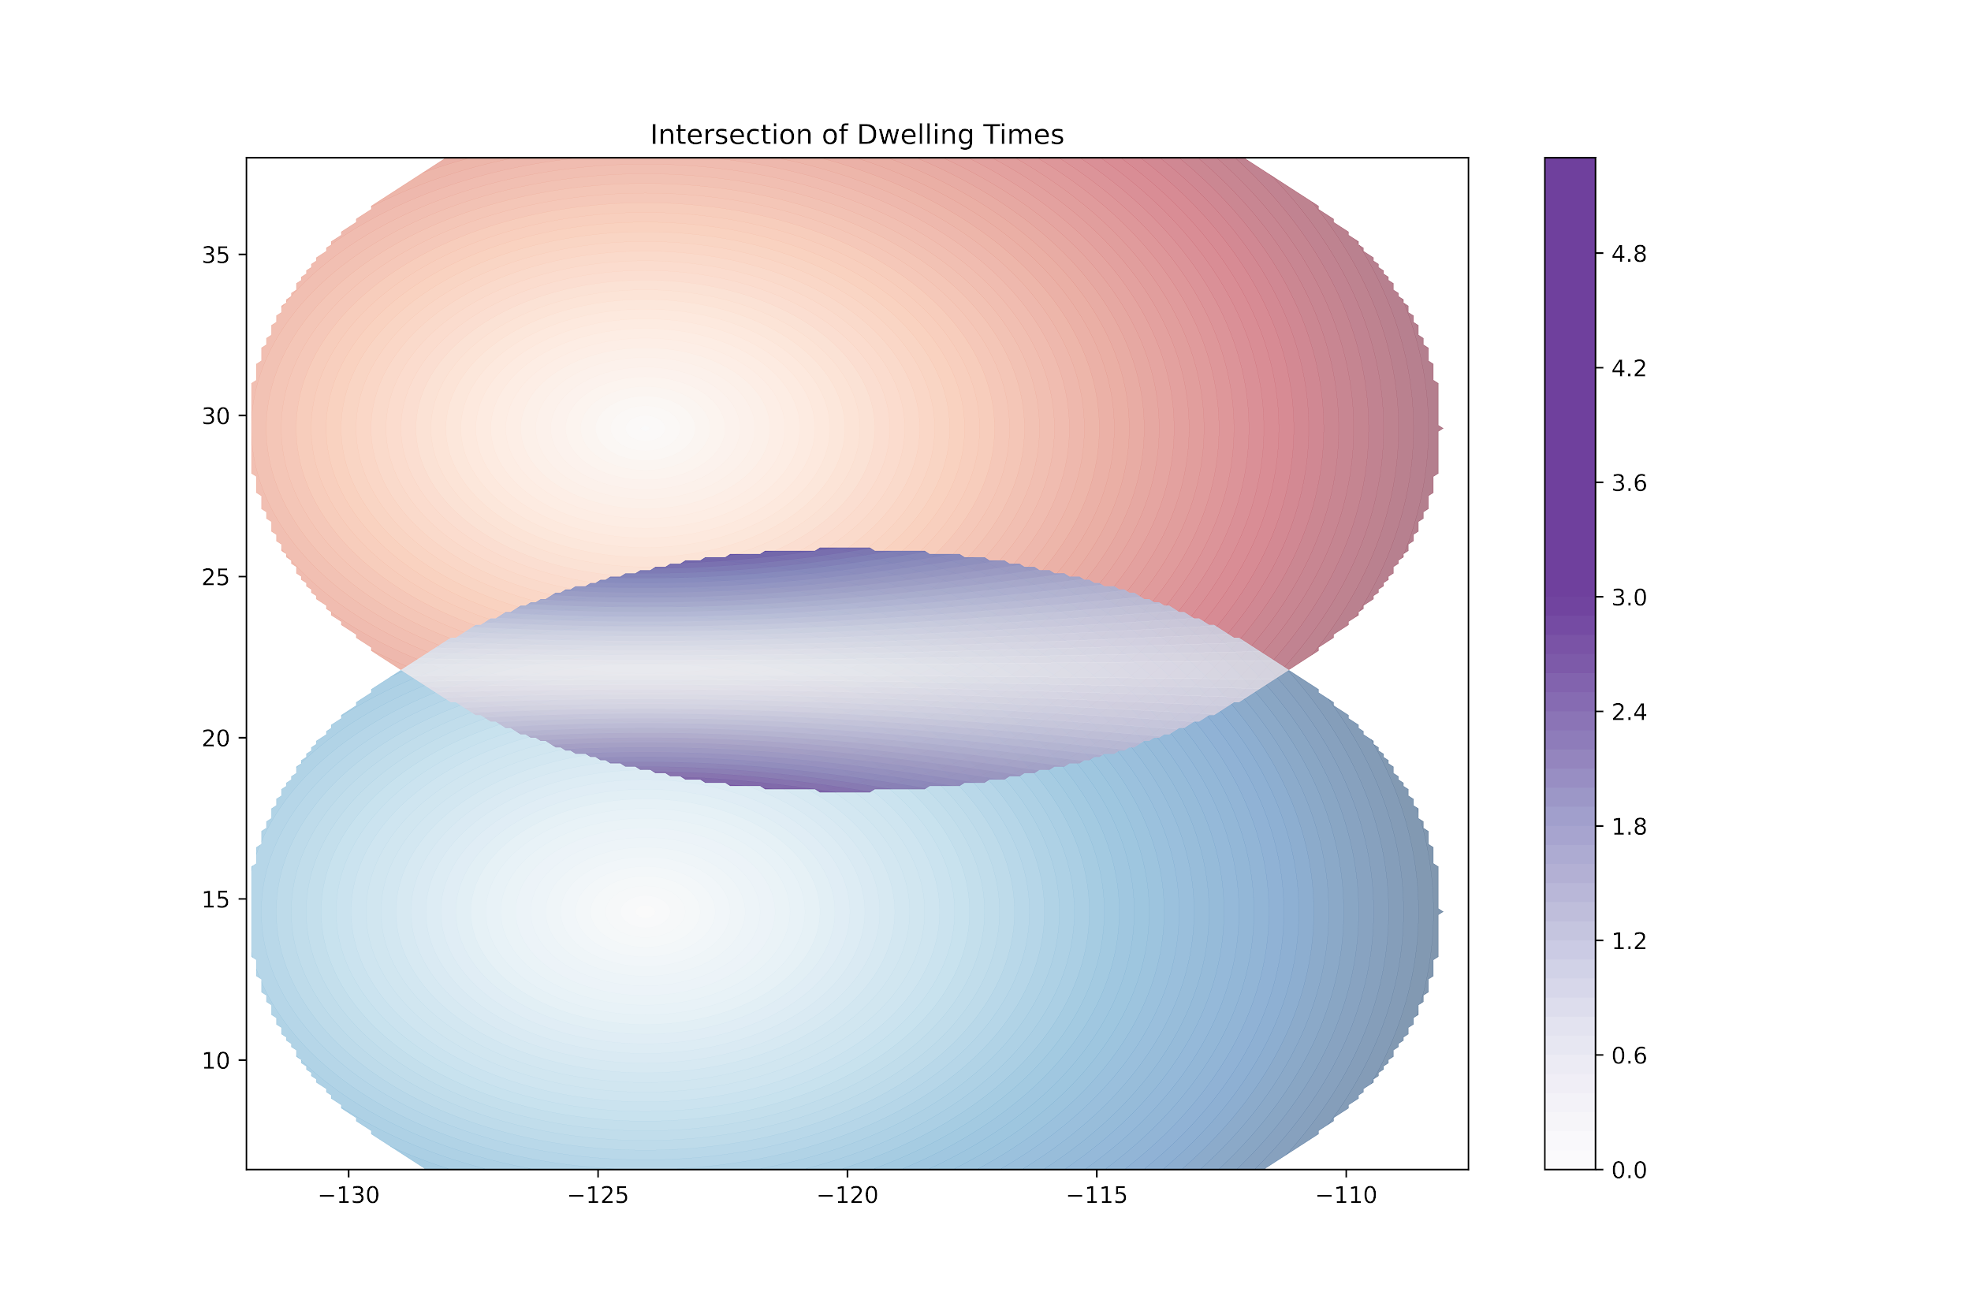
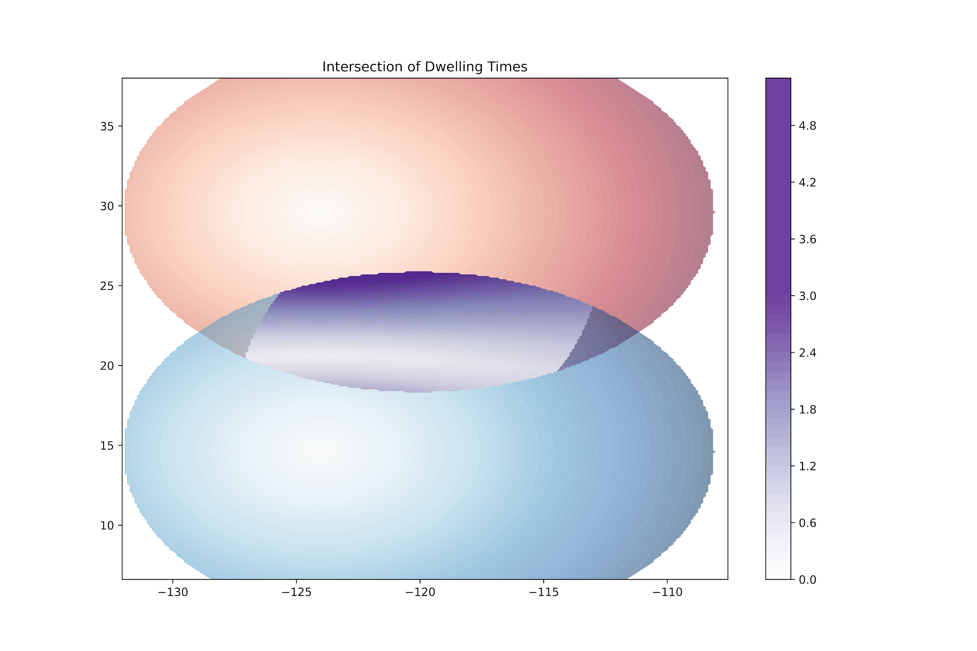
More Behavioral Patterns
Same parameters
More behavioral patterns within gaps can be captured via varying different parameters
E.g., Max Speed, Start Time
Waiting time and Meeting length changes accordingly.
Case 1
Same Parameters:
Speed, start time, and time gap are similar
Case 2
Blue start time offset by +1:
Start time is increased by +1
Blue start time offset by +1
Intersections depict waiting time
Notes:
consider removing or hiding

Slide 15
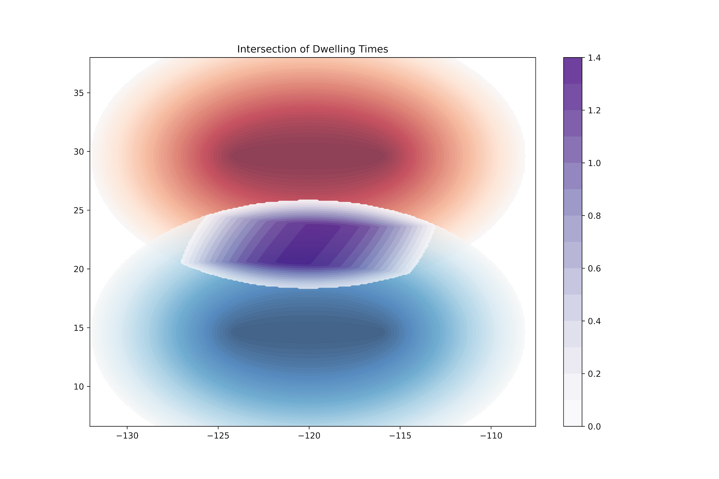
Mapping Meeting-Time Lengths
Meeting time is also captured and visualized by our work:
Case 1: Identical Parallel Trajectories
Same parameters of both Red and Blue:
start_time = 0
time gap = 8
speed = 3
Case 2: Blue Delayed Parallel Trajectories
Blue is delayed by 1 unit of time (offset by +1):
Red
start_time = 0 (no changes)
Blue
start_time = 1
Fig: Identical Parallel Trajectories
Fig: Blue Delayed Parallel Trajectories
Notes:
Individual: Dwell Time
Two Gaps: Meeting Time
Stick to consistent color: Dwell time Object 1, Dwell time Object 2, Meeting Time
separate dwelling time from meeting, use common scale, more descriptive of the figure in slides/report

Slide 16
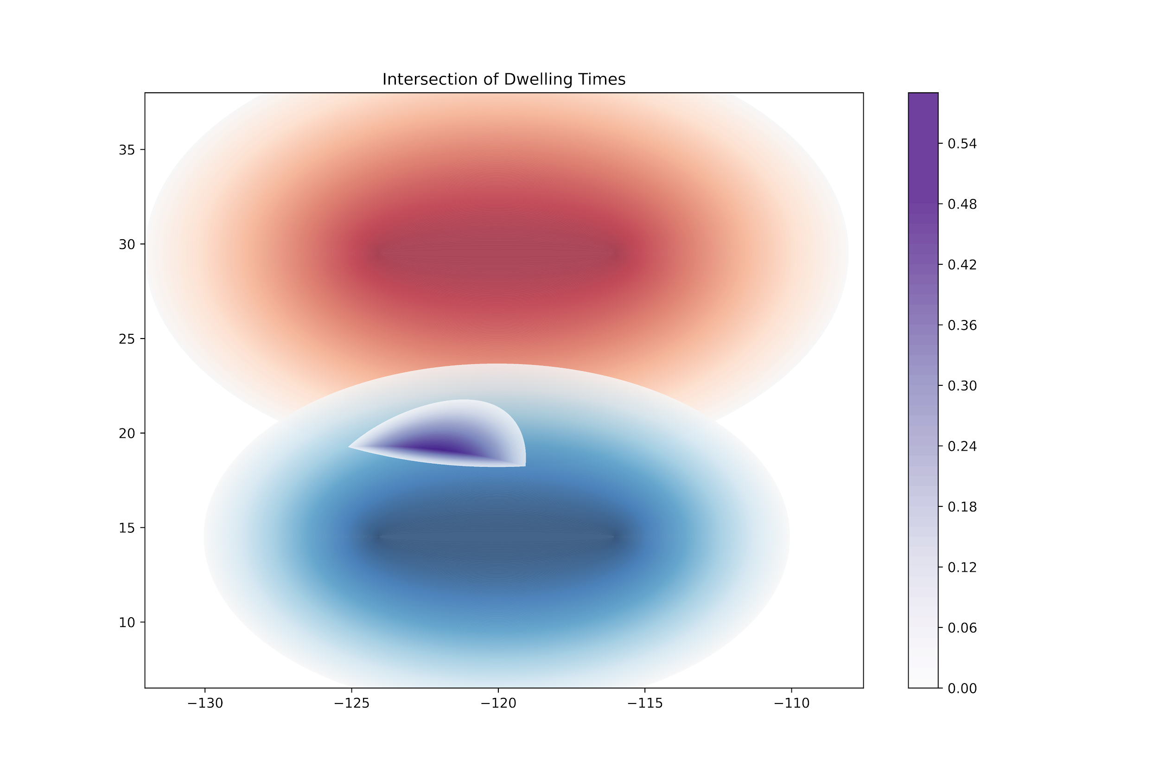
Mapping Meeting-Time Lengths
The proposed approach can also handle more complex use cases:
Case 3: Blue Delayed and Increase Time Gap
Reduced potential meeting areas due to parameters
Multiple parameters are altered:
Red
start_time = 0
time_gap = 8
speed = 3
Blue
start_time = 1
time_gap = 10
speed = 2
Fig: Blue Delayed and Increase Time Gap
Notes:
explicit parameter mention, name cases, summary cases
Multiple parameters altered:
Red same parameters
Blue decreased speed
Blue starts later
Blue increased time gap
Finer grids are also used for more precision.

Slide 17
Discussion
Assumption: Object heads straight to the selected grid cell,
Unrealistic in cases where the trajectory has many curves.
Computationally Expensive in case of finer grids.
We do not take into account acceleration
Use Case: Proposed method is inaccurate when object is decelerating.
Notes:
as we only use a max speed.

Slide 18
Conclusion and Future Work
Conclusion:
We defined trajectory gap behavior based on meeting time.
We calculated the potential meeting times and locations for the pair of trajectories.
We provided experimental results based on visualizations.
Future Work:
We plan consider more realistic physics based models [2]
We plan to include acceleration
We plan to real-world dataset and analyze other behaviors of entities
We plan to add probabilistic interpretation in trajectory gaps:
Gaussian Processes
Notes:
We defined trajectory gap behavior based on meeting time.
We calculated the potential meeting times and locations for the pair of trajectories.
We provided experimental results based on visualizations.
Use a real-world dataset and analyze behaviors of entities

Slide 19
Reference
[1] Miller, Harvey J. "Time geography and space-time prism." International encyclopedia of geography: People, the earth, environment and technology 1 (2017).
[2] Kuijpers, Bart, Harvey J. Miller, and Walied Othman. "Kinetic space-time prisms." In Proceedings of the 19th ACM SIGSPATIAL international conference on advances in geographic information systems, pp. 162-170. 2011.
[3] Dodge, Somayeh, Robert Weibel, and Anna-Katharina Lautenschütz. "Towards a taxonomy of movement patterns." Information visualization 7, no. 3-4 (2008): 240-252.
[4] Zheng, Yu. "Trajectory data mining: an overview." ACM Transactions on Intelligent Systems and Technology (TIST) 6, no. 3 (2015): 1-41.
Notes:
We defined trajectory gap behavior based on meeting time.
We calculated the potential meeting times and locations for the pair of trajectories.
We provided experimental results based on visualizations.
Use a real-world dataset and analyze behaviors of entities

Slide 20
Our Work
Ellipses are now colored based on time to site.
Intersection in the following plots indicate the waiting time for an object.
Same parameters
Blue start time offset by +1

Slide 21
Future Work
Use a real-world dataset and analyze behaviors of entities
Compare space-time prisms with gaussian processes for predicting location
Increase graph accuracy
Work with acceleration
Work with more than two moving objects

Slide 22
Questions?
Notes:
https://github.com/Jazzyforcefield/double_trajectory

